Slide 1

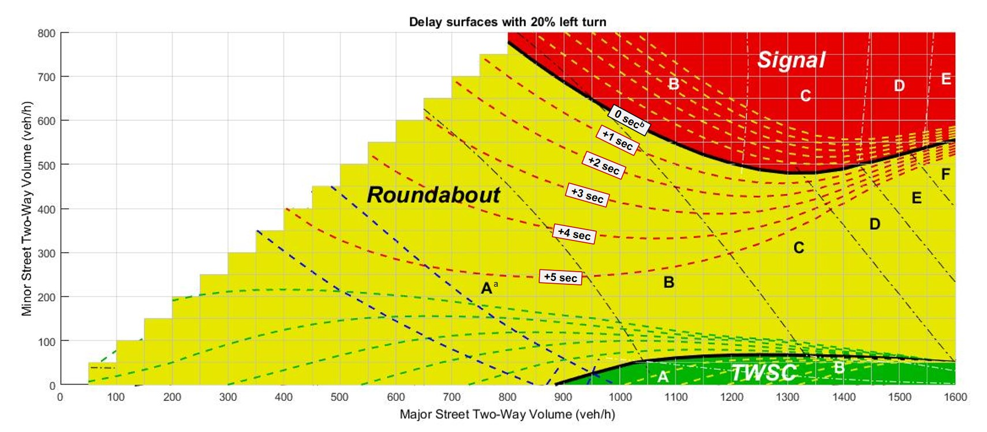
A Gray Zone in Isolated Intersection Control Type Selection
# 17-02609, Poster: Tue. 8:00-9:45 AM, J340 Hall E
Bumjoon Bae, PhD Student
Two-way stop control (TWSC), all-way stop control (AWSC), signal control, and roundabout types were compared in delay with various demand conditions using HCM 2010.
A gray zone in intersection control type selection was identified to consider uncertainties in delay calculation.

